Slide 1
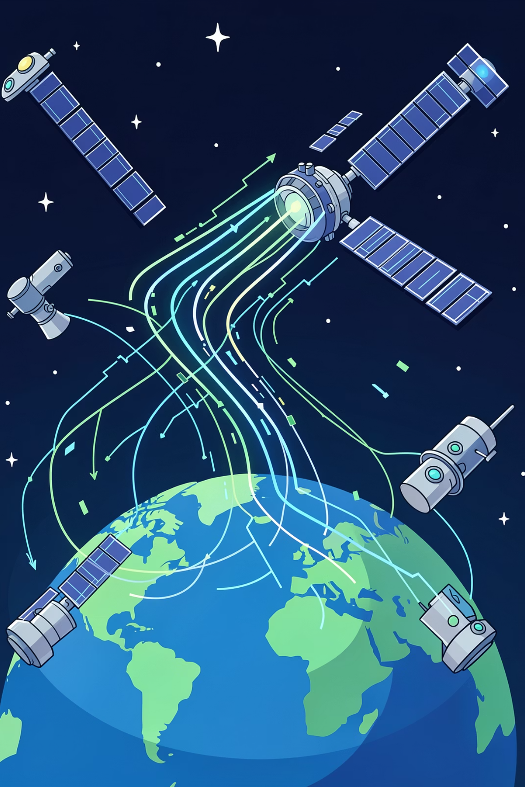
Recurring Unknown Anomaly Detection Using Machine Learning
Presenter: Arshana N
Guide: Miss Thennel K A

Slide 2
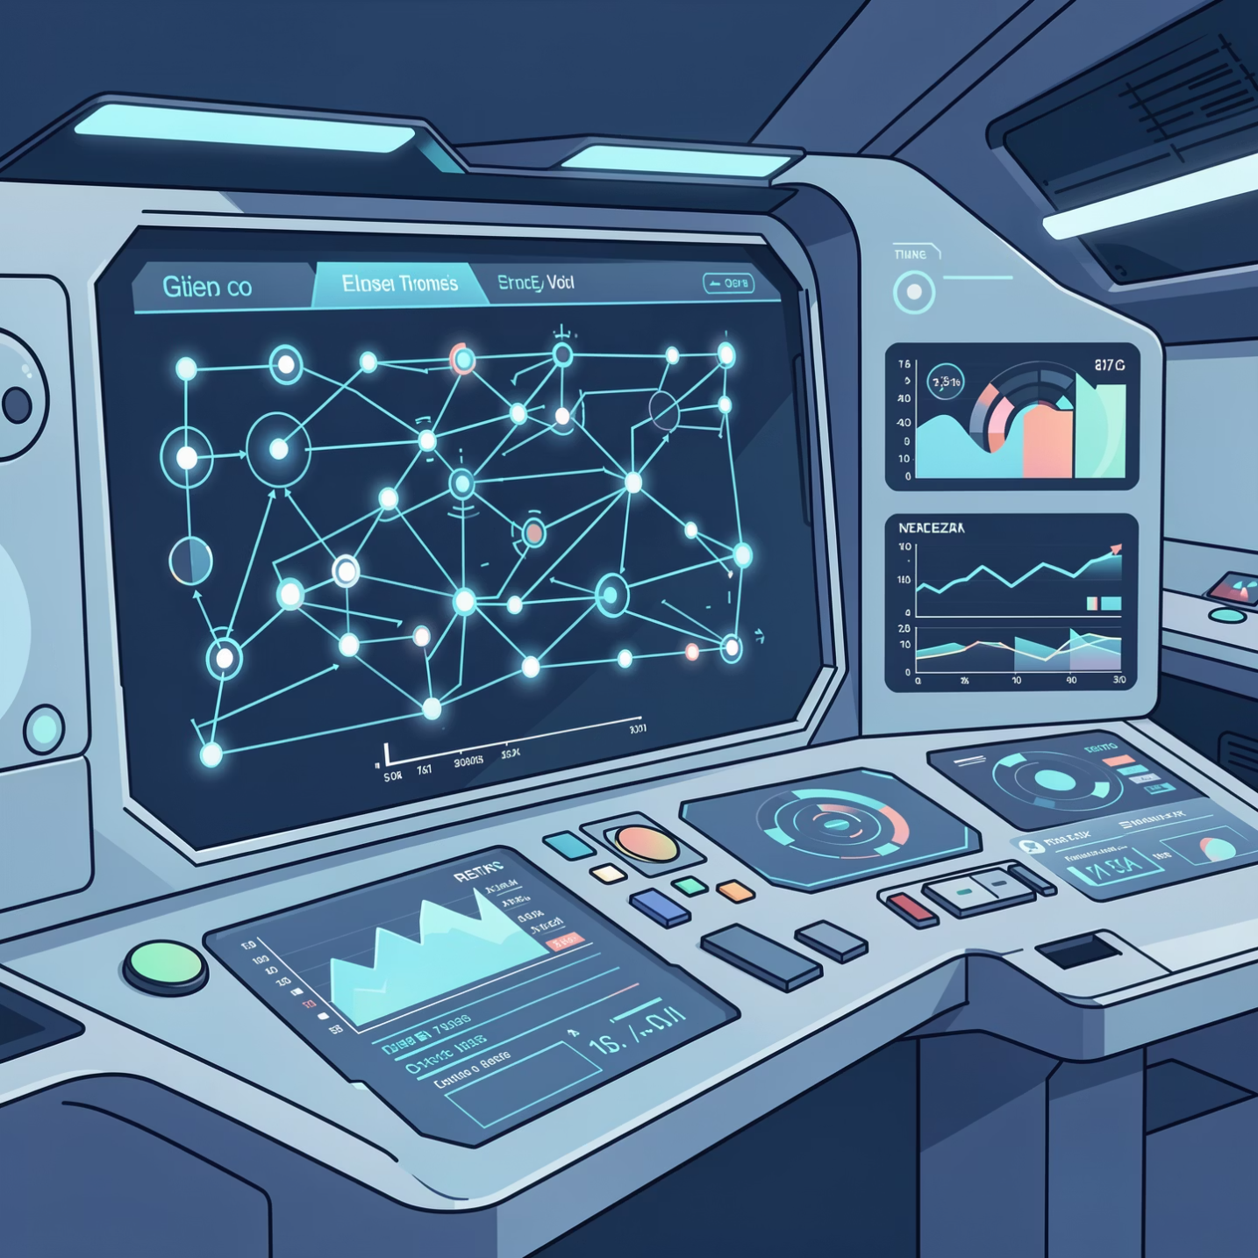
INTRODUCTION
Understanding Anomaly Detection in Telemetry Systems
What is Anomaly Detection?
Anomaly detection identifies unusual patterns in data that deviate from expected behavior. In spacecraft telemetry, these anomalies can signal potential equipment failures or system malfunctions.
Why Recurring Anomalies Matter
Recurring anomalies represent patterns that repeat over time, often indicating systematic issues rather than isolated events. Detecting these patterns enables predictive maintenance and prevents catastrophic failures in mission-critical systems.

Slide 3
PROBLEM STATEMENT
Challenges in Traditional Anomaly Detection
Unknown Anomalies
Recurring Patterns
Need for ML
Traditional rule-based methods rely on predefined patterns and fail to detect previously unseen anomaly types in complex telemetry data.
Identifying anomalies that repeat across time requires sophisticated pattern recognition beyond conventional threshold-based approaches.
Machine learning offers unsupervised methods to discover hidden patterns and detect novel anomalies without prior labeling or domain-specific rules.

Slide 4
OBJECTIVE
Research Goals and Objectives
01
02
Detect Unknown Anomalies
Identify Recurring Patterns
Apply unsupervised machine learning to identify anomalies without predefined labels or rules.
Develop methods to recognize anomaly patterns that repeat across multiple time windows.
03
04
Validate Against NASA Labels
Visualize Insights
Compare machine learning results with expert-labeled anomalies from NASA datasets.
Create interactive dashboards for intuitive exploration and interpretation of detected anomalies.

Slide 5
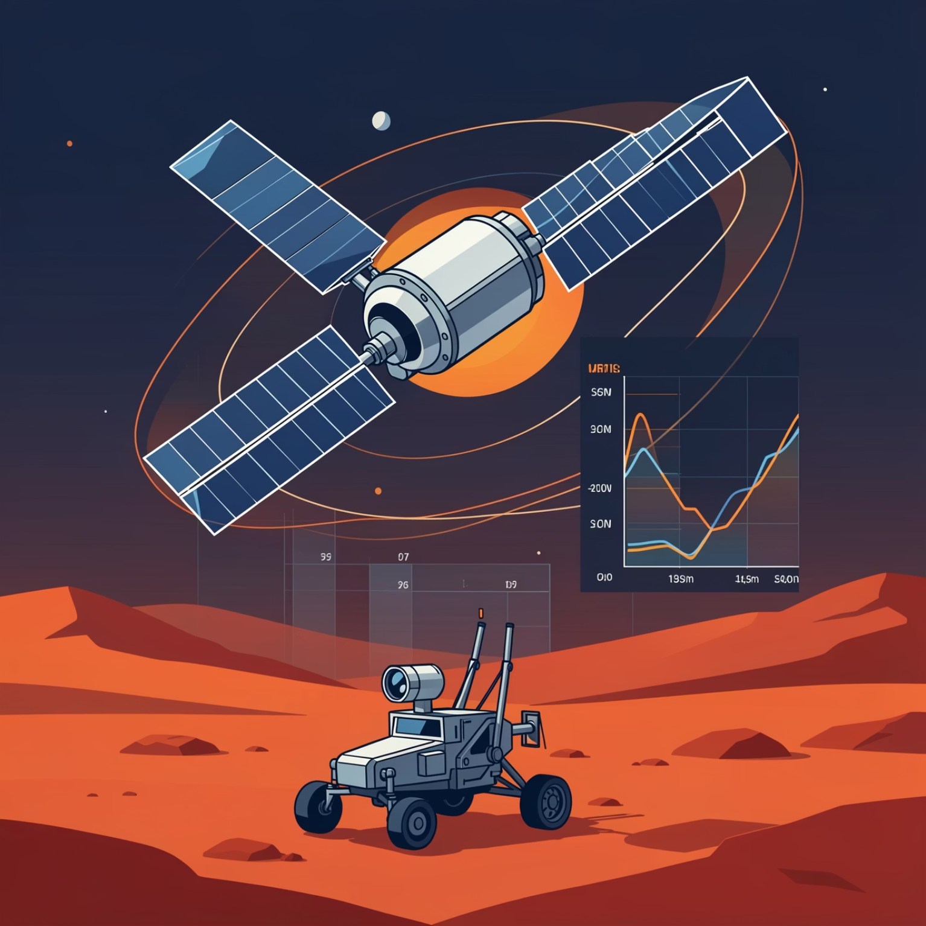
DATASET
NASA SMAP & MSL Telemetry Data
Dataset Overview
The NASA Anomaly Detection Dataset comprises telemetry data from the Soil Moisture Active Passive (SMAP) satellite and Mars Science Laboratory (MSL) rover. It contains multivariate time-series sensor readings with expert-labeled anomaly segments.
Data Structure
Multiple sensor channels in .npy format
labeled_anomalies.csv with NASA annotations
Real-world spacecraft operational data
Ground truth for model validation
View Dataset on Kaggle

Slide 6
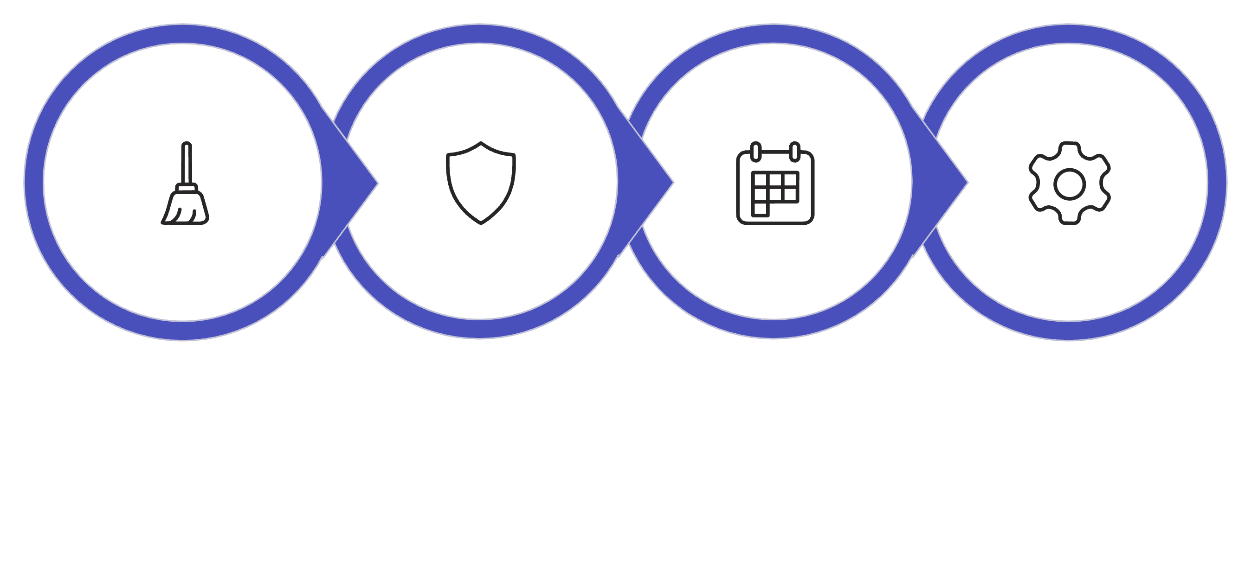

METHODOLOGY
Machine Learning Pipeline
Isolation Forest
Rolling Window
Hyperparameter Tune
Preprocess
The methodology employs Isolation Forest for unsupervised anomaly detection, combined with rolling window analysis to identify recurring patterns across time series. GridSearchCV optimizes contamination rate and tree parameters for maximum detection accuracy.

Slide 7
RESULTS
Results and Analysis
Key Findings
The Isolation Forest model successfully detected both known and unknown anomalies in the telemetry data. Analysis revealed recurring patterns that aligned with NASA's expert labels while also identifying previously unlabeled anomalous segments.
Three Categories of Anomalies
NASA-labeled anomalies: Expert-identified segments
ML-confirmed anomalies: Overlapping detections
ML-only anomalies: Novel unknown patterns
The recurring anomaly detection algorithm identified segments with similar temporal characteristics, enabling pattern-based classification and predictive insights.

Slide 8
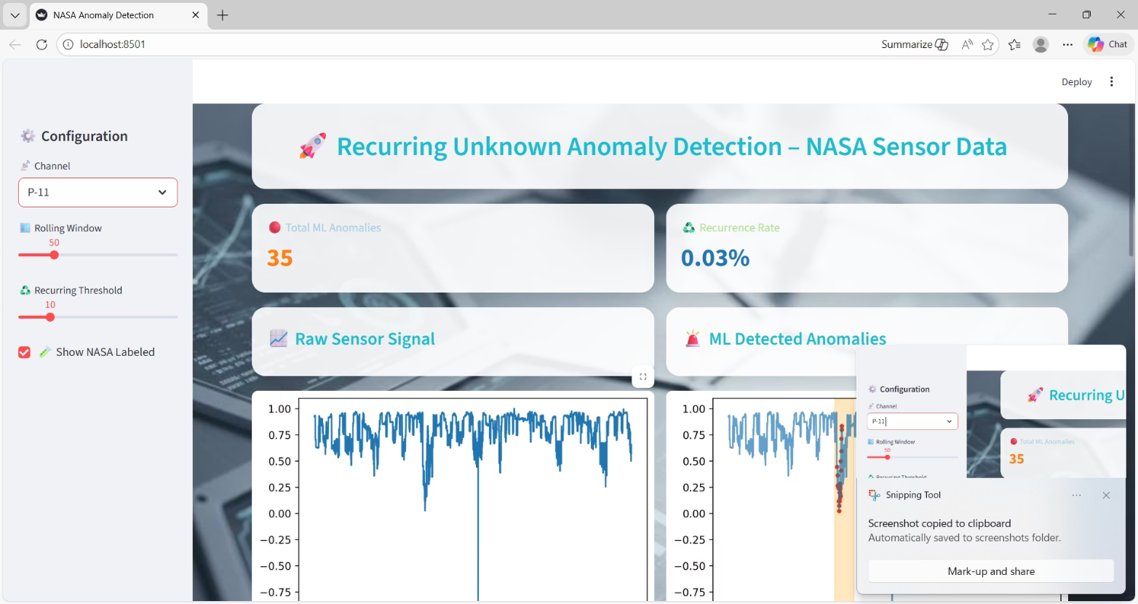
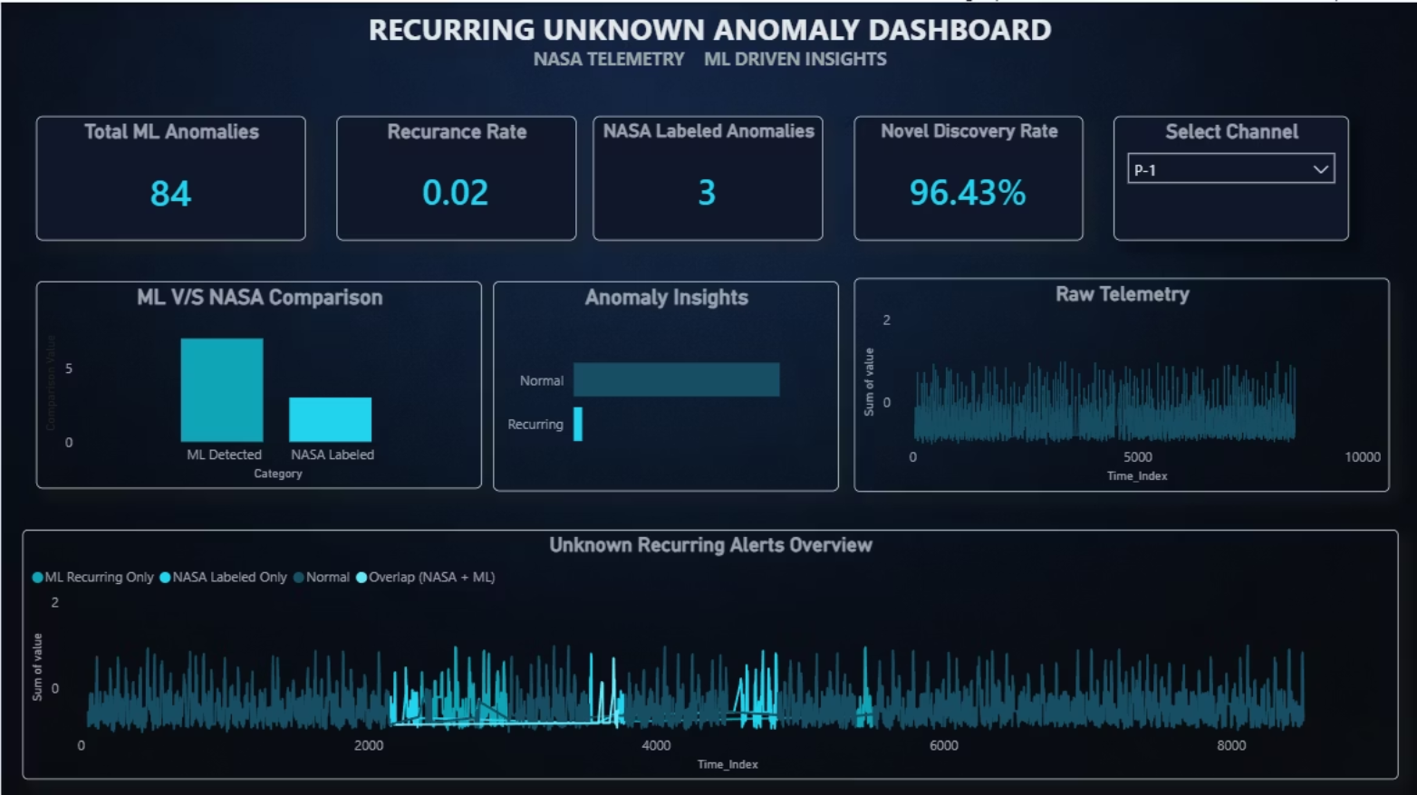
VISUALIZATION
Interactive Dashboard Systems
Streamlit Dashboard
Power BI Analytics
Real-time interactive visualization enabling users to explore detected anomalies, filter by channels, and compare ML results with NASA labels.
Comprehensive analytics dashboard providing summary statistics, recurring pattern analysis, and comparative visualizations across sensor channels.

Slide 9
CONCLUSION
Key Takeaways
Successful Detection
Validation Achieved
Enhanced Interpretability
The Isolation Forest model effectively identified recurring unknown anomalies in spacecraft telemetry data, demonstrating the viability of unsupervised learning for this application.
Results showed strong alignment with NASA's expert-labeled anomalies while discovering additional patterns, validating both the model's accuracy and its ability to detect novel anomalies.
Interactive dashboards transform complex detection results into actionable insights, enabling engineers and analysts to understand and respond to anomalous behavior efficiently.

Slide 10

FUTURE SCOPE
Future Research Directions
Real-Time Detection
Implement streaming anomaly detection for live telemetry monitoring with minimal latency.
Live Deployment
Deploy the model on operational spacecraft systems for continuous monitoring and validation.
Automated Alerting
Develop intelligent alert systems that notify mission control of critical recurring anomalies automatically.

